Slide 1
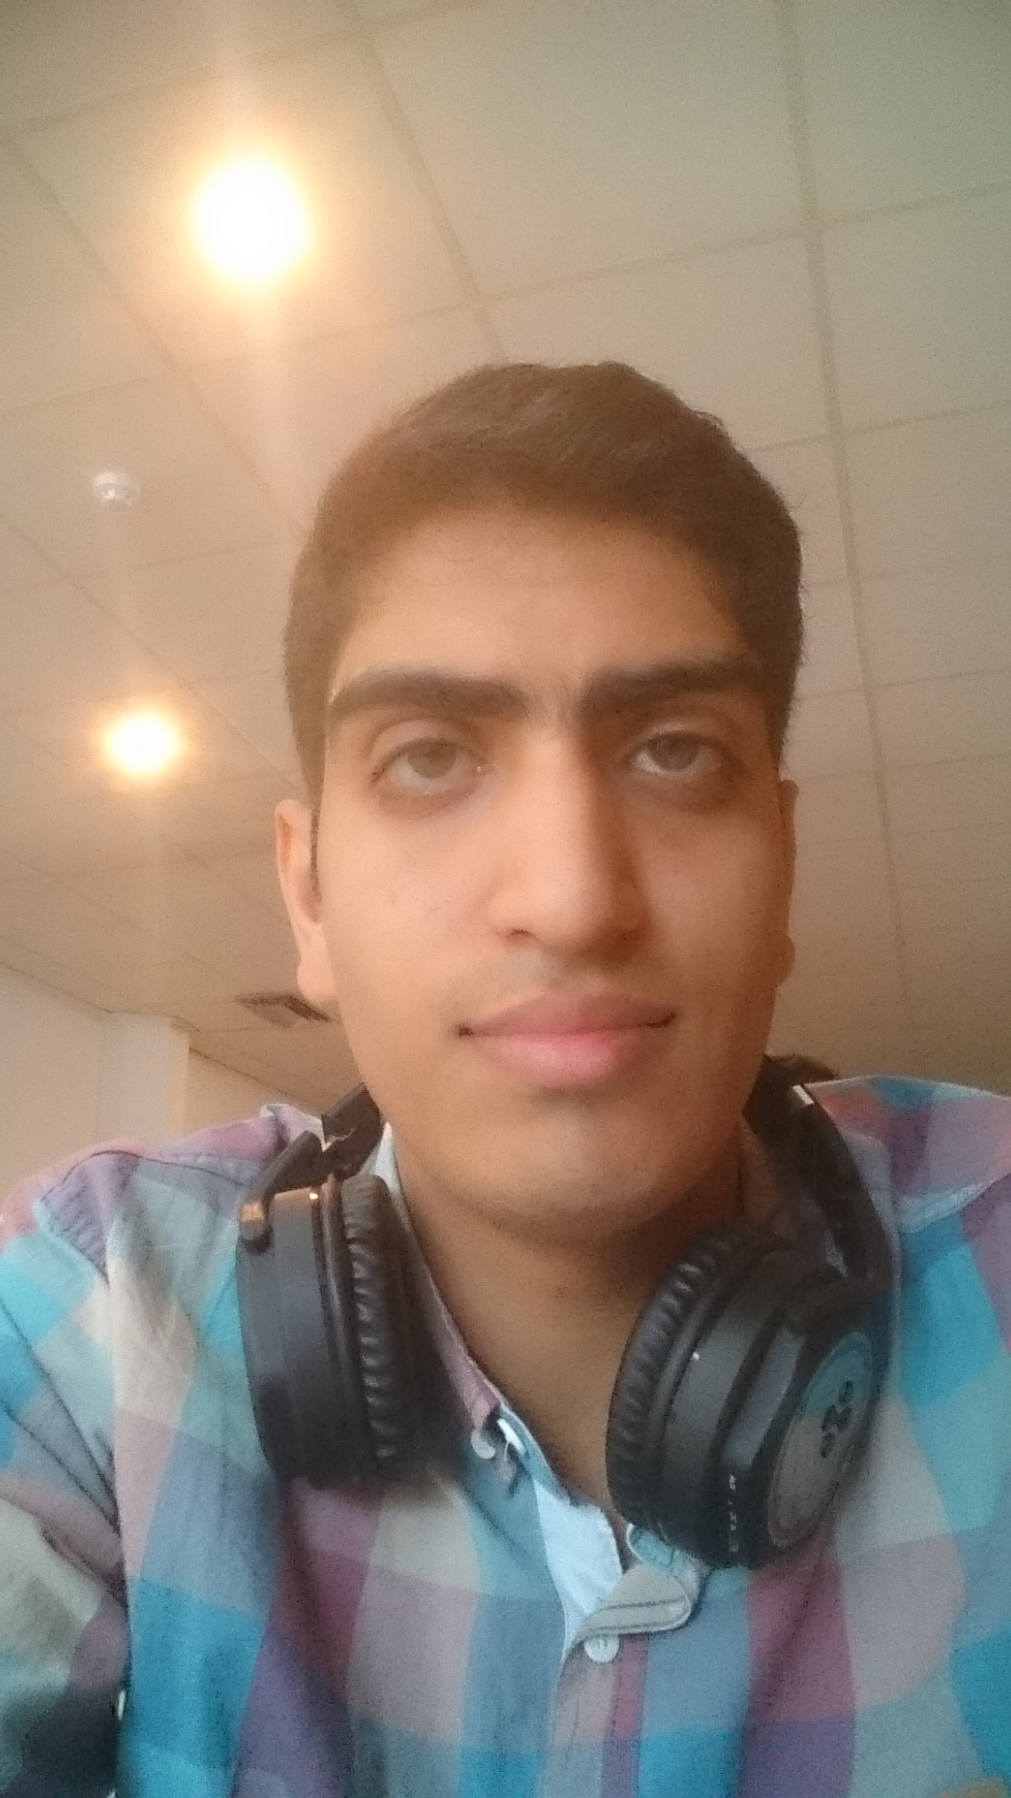
Mohammad Sabouri
Master student of Genova University in field of Robotic Engineering.
Master's Degree in Electrical-Control Engineering, Shiraz University, Shiraz, Iran.
Laurea Magistrale in Ingegneria dell'Elettrocontrollo, Università di Shiraz, Shiraz, Iran.

Slide 2
EDUCATION My background
Master of Science in Control Engineering.
Modelling and control of non-holonomic mobile robots using the quasi-LPV method.
LPV and quasi-LPV Techniques
LMI Techniques for Solve LPV Equation
Modeling and remodeling
Bachelor of Science in Electrical Engineering, with a specialty in Control.
Design and implementation of sound compass for trajectory control of mobile robot.
Diploma:
Diploma in Industrial Electricity Discipline.
Diploma in Mathematics and Physics Discipline.

Slide 3
Research Interest
Control Theory | Control of Linear Parameter Varying (LPV) systems Robust control Controller Allocation Nonlinear Control, Lyapunov Theory
Robotic & Mechatronic | Complex Mechatronic Devices Rehabilitation Robot and Devices Path Planning and Motion Planning Autonomous Systems and Vehicles
Data science & Artificial Intelligent | Machine Learning, Neural Network Application Data Analysis & Data Mining

Slide 4
Research Interest
Control Theory | Control of Linear Parameter Varying (LPV) systems Robust control Controller Allocation Nonlinear Control, Lyapunov Theory
Robotic & Mechatronic | Complex Mechatronic Devices Rehabilitation Robot and Devices Path Planning and Motion Planning Autonomous Systems and Vehicles
Data science & Artificial Intelligent | Machine Learning, Neural Network Application Data Analysis & Data Mining

Slide 5
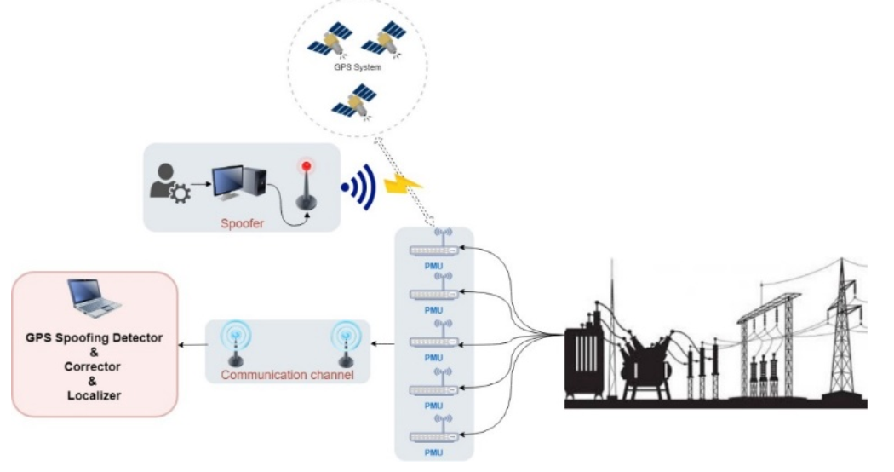
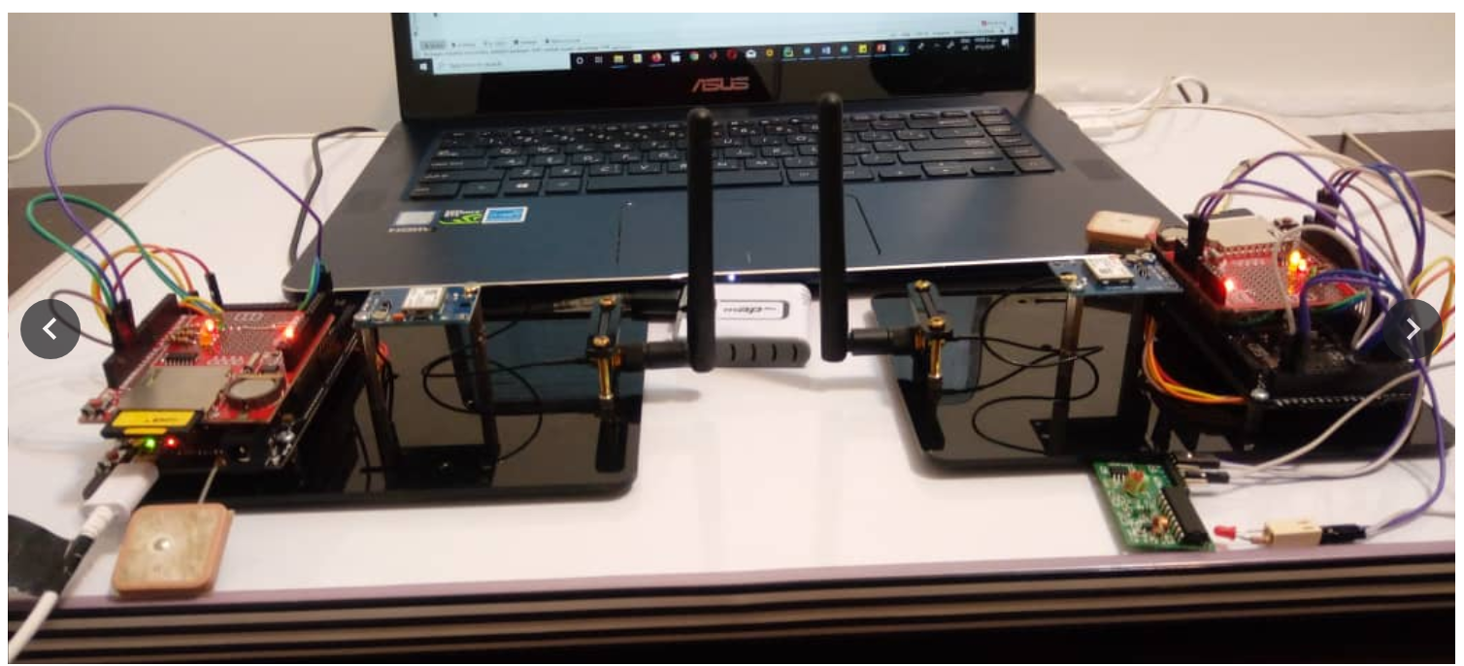
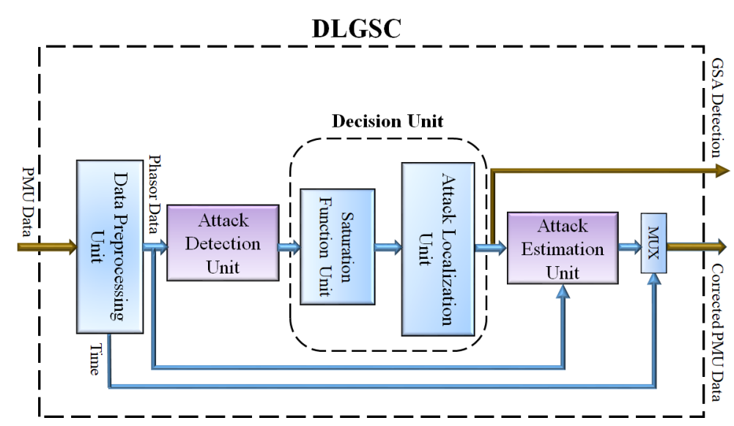
PUBLICATIONS
1-Sabouri, Mohammad, Sara Siamak, Maryam Dehghani, Mohsen Mohammadi, Mohammad Hasan Asemani, Mohammad Reza Hesamzadeh, and Vedran Peric. " Increasing the resiliency of power systems in presence of GPS spoofing attacks: A data‐driven deep‐learning algorithm." IET Generation, Transmission & Distribution (2023).

Slide 6
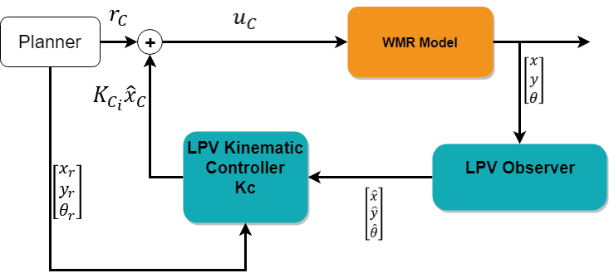
PUBLICATIONS
1-Sabouri, Mohammad, and Mohammad Hassan Asemani. "LPV Controller Design for Trajectory Tracking of Non-holonomic Wheeled Mobile Robots in the Presence of Slip."202129th Iranian Conference on Electrical Engineering (ICEE).IEEE.(2021,October).

Slide 7
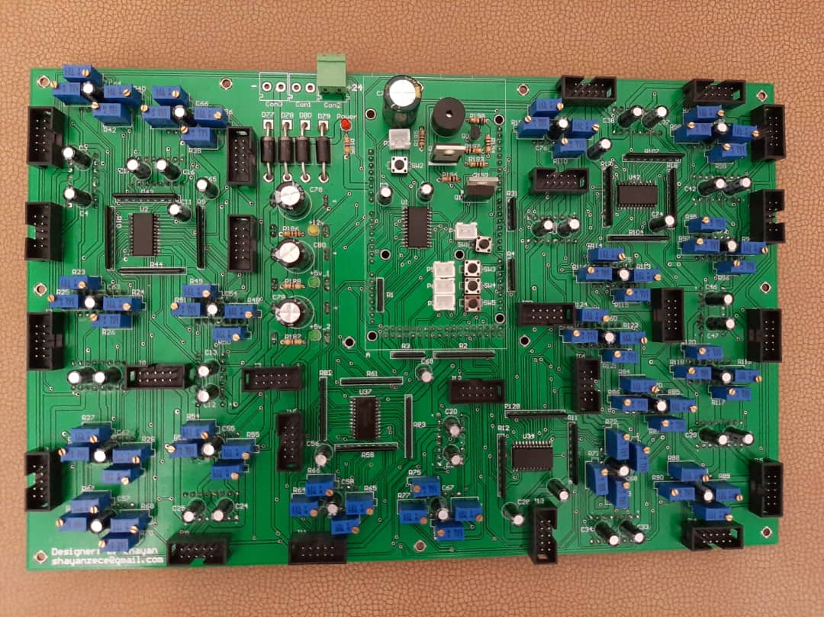
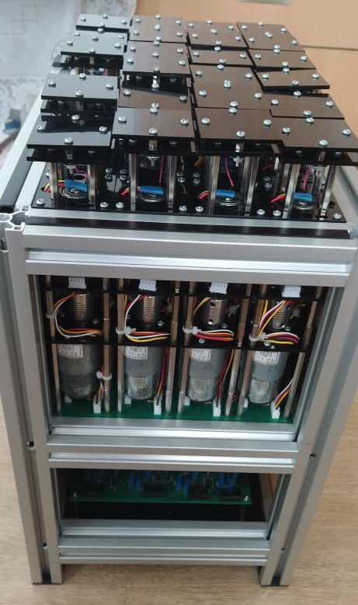
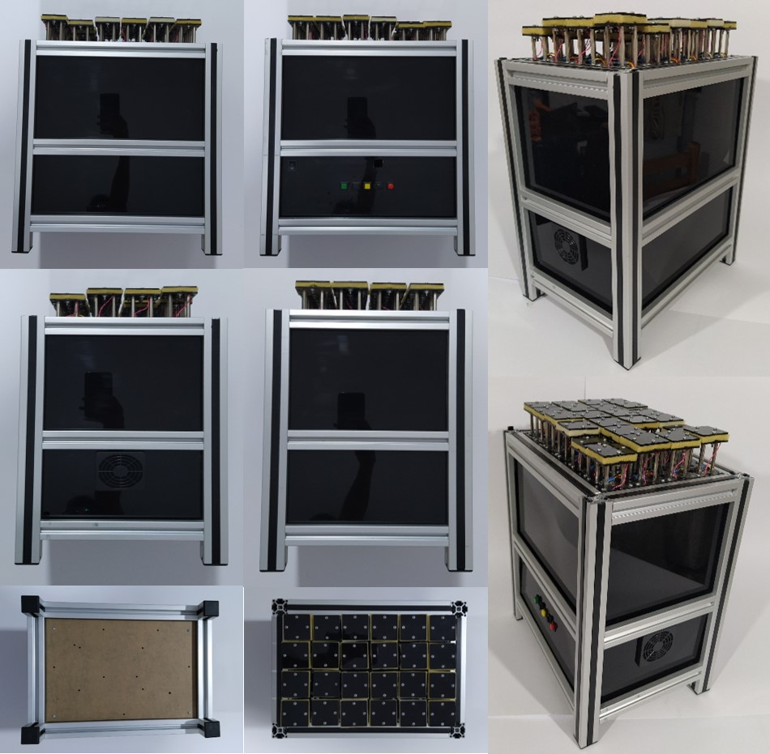
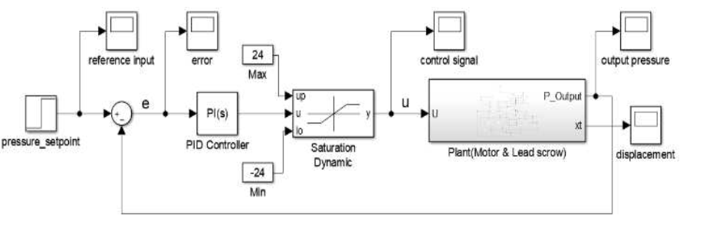
PUBLICATIONS
2-Shayan, Z.,Sabouri, M., Shayan, M., Asemani, M. H., Sarmoori, A. B., & Zare, M.,“Pressure Control of Cellular Electromechanical Medical Mattress For BedsorePrevention,”7th International Conference on Control, Instrumentation and Automation (ICCIA),IEEE. (2021, February).

Slide 8
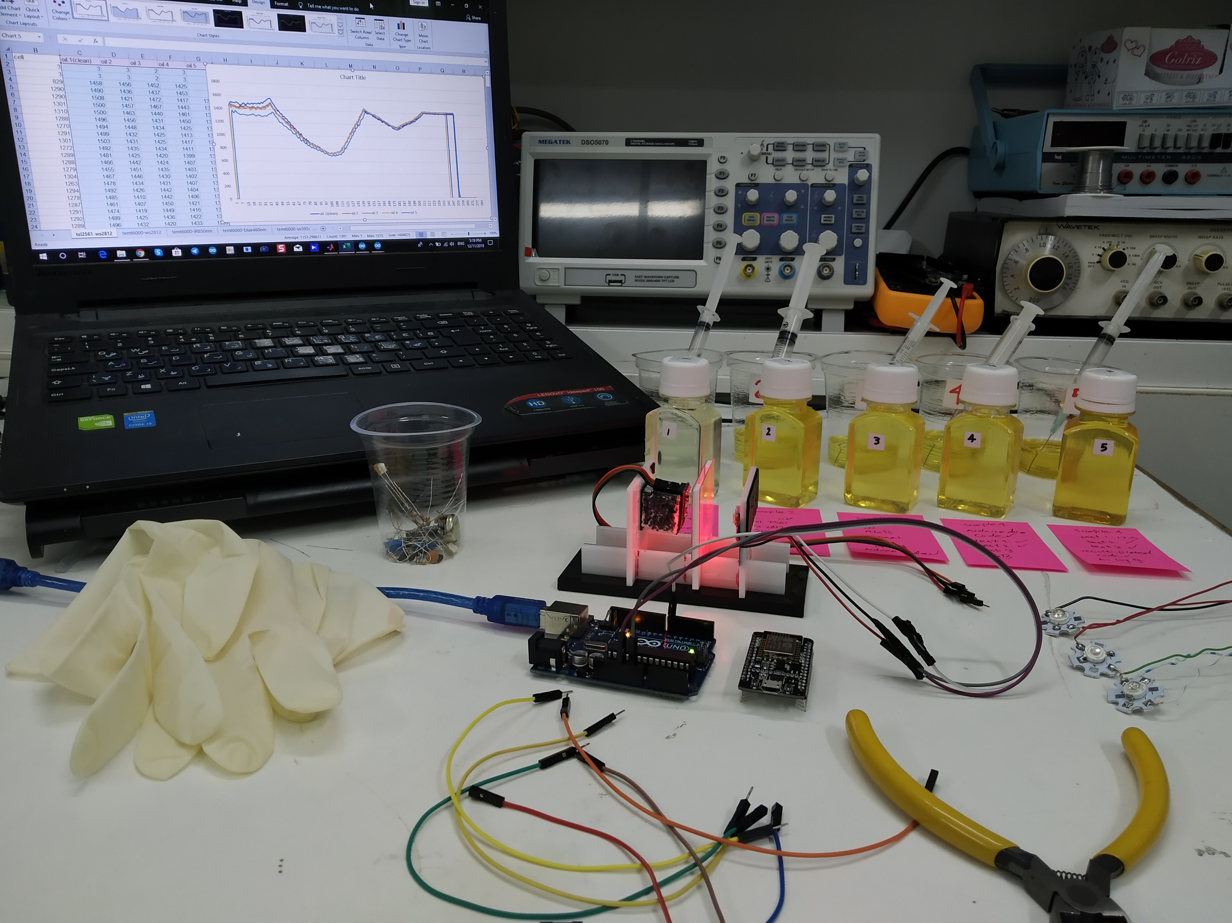
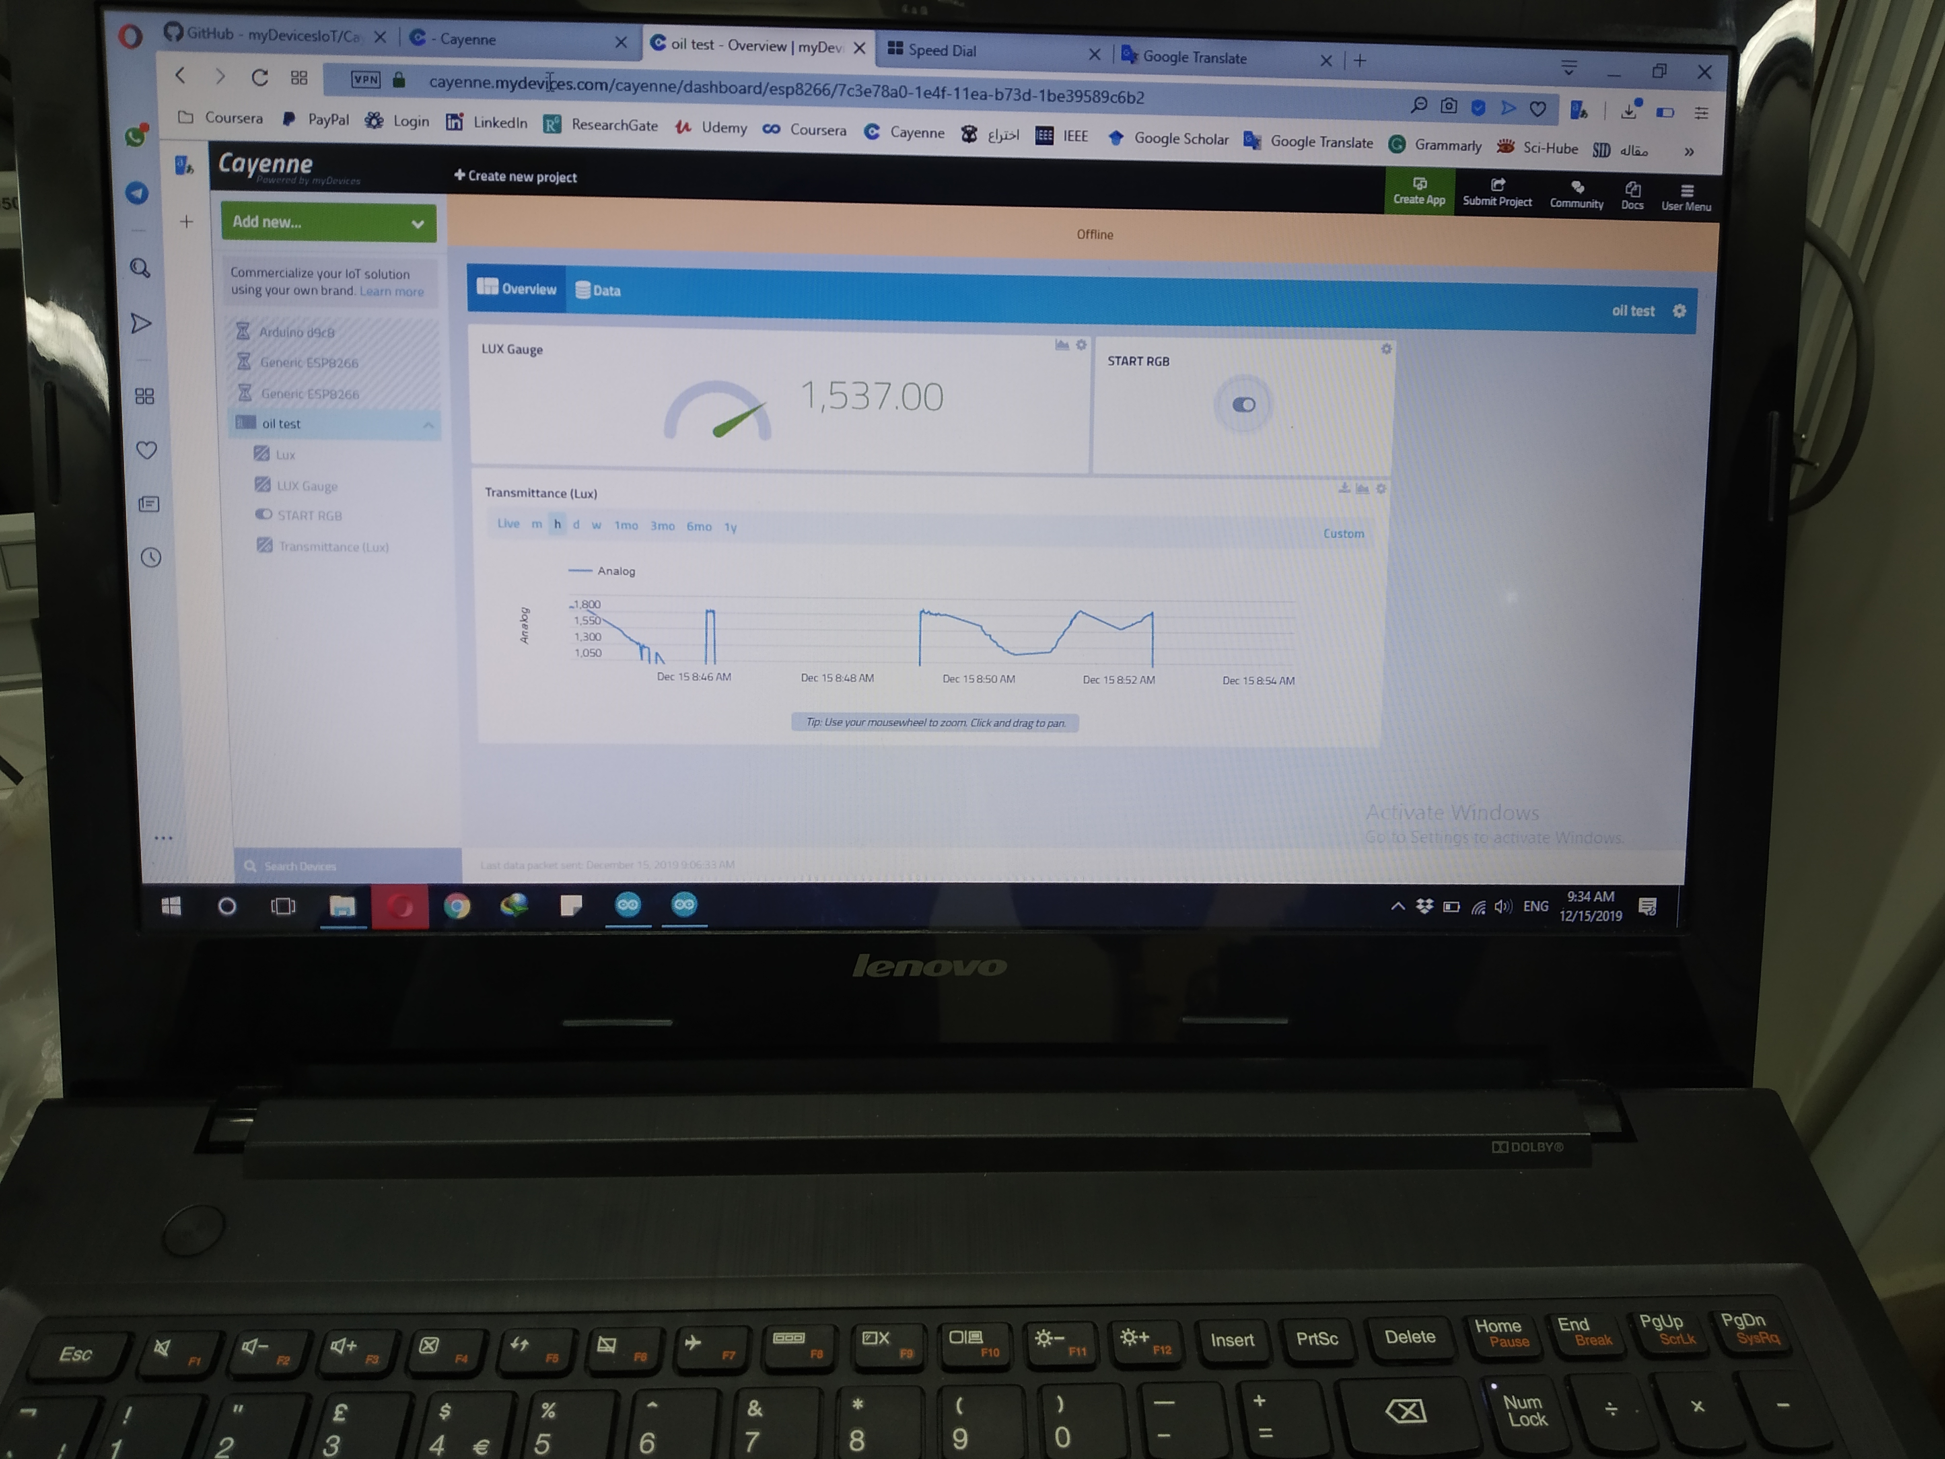
PUBLICATIONS
3-Firouzimagham, D., Aminaie, P., Shayan, Z.,Sabouri, M., & Asemani, M. H., “Online Transformer Oil Analysis Based on Spectroscopy Technique and Machine Learning Classifier: Experimental Setup,”15th International Conference on Protection and Automation of Power Systems (IPAPS). IEEE. 2020.

Slide 9
PUBLICATIONS
4-M. Sabouri,P. Setoodeh, M.H. Asemani, ''Construction of Lyapunov Functions using Multi-Objective Genetic Algorithm'',28thIranian Conference on Electrical Engineering (ICEE), Tabriz University,2020,Tabriz, Iran.
5-M. Zare, M. Jampour, A.S. Arezoomand,M. Sabouri, “Handwritten Recognition basedon Hand Gesture Recognition using Deterministic Finite Automata and Fuzzy Logic,” 4th International Conference on Pattern Recognition and ImageAnalysis(IPRIA), 2019, Tehran, Iran. IEEE.

Slide 10
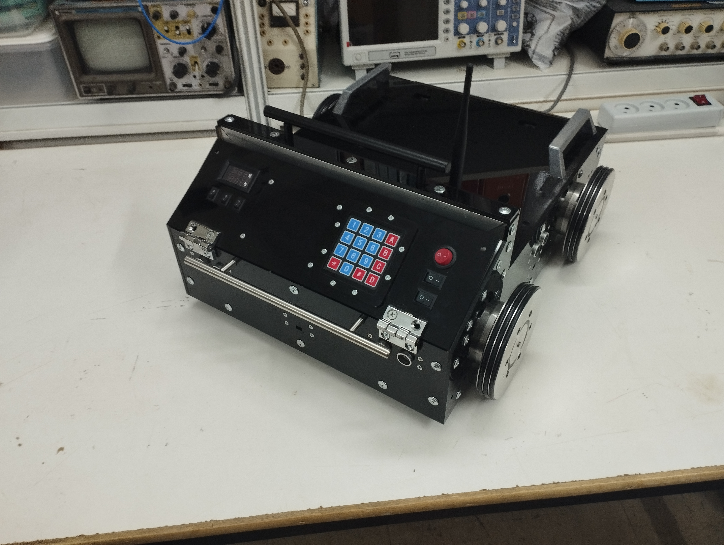
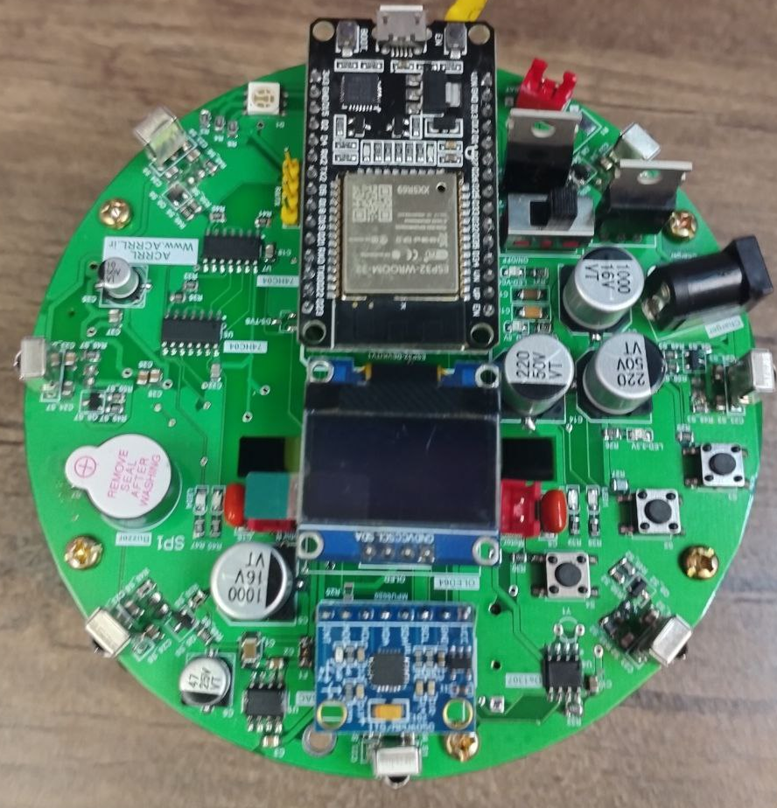
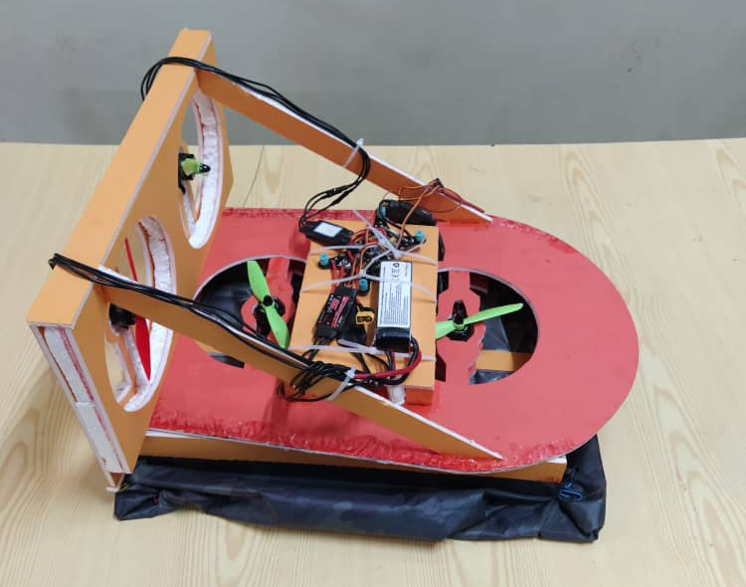
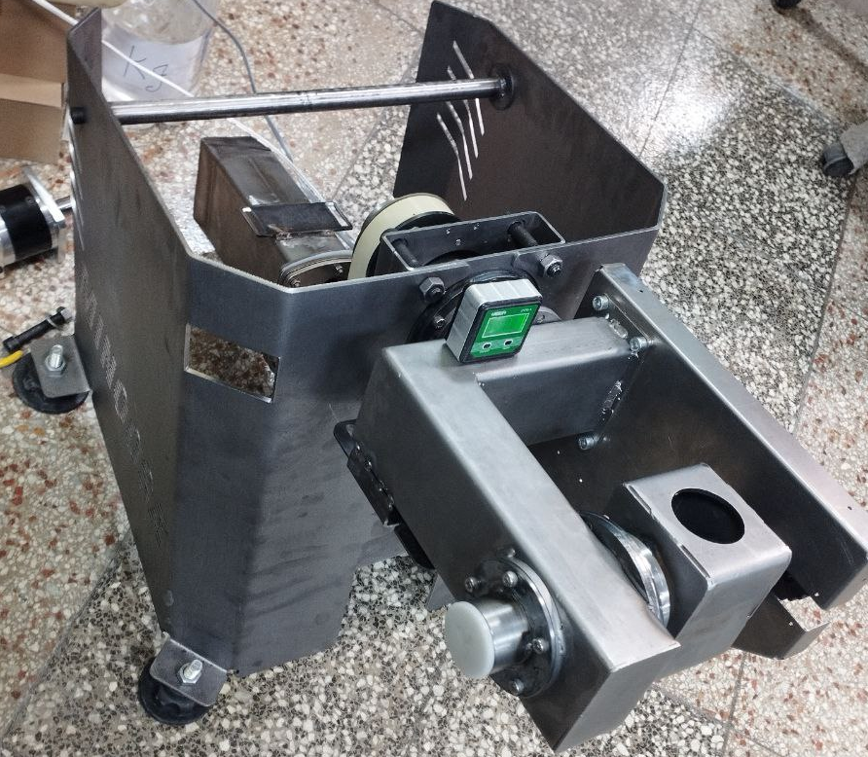
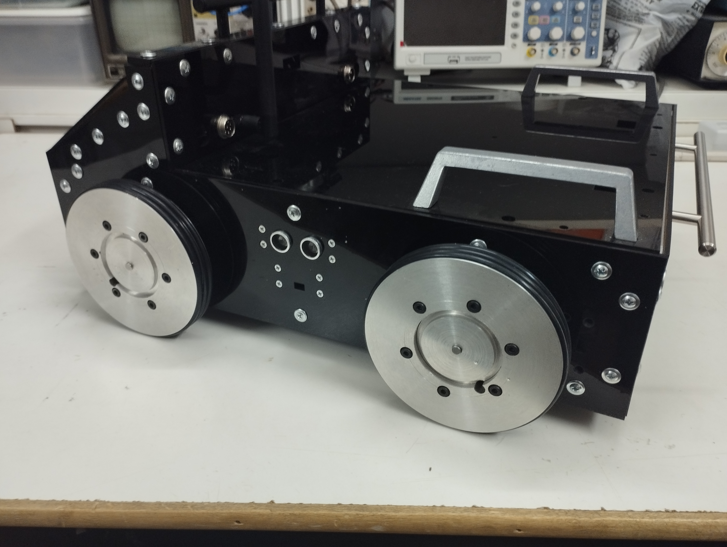
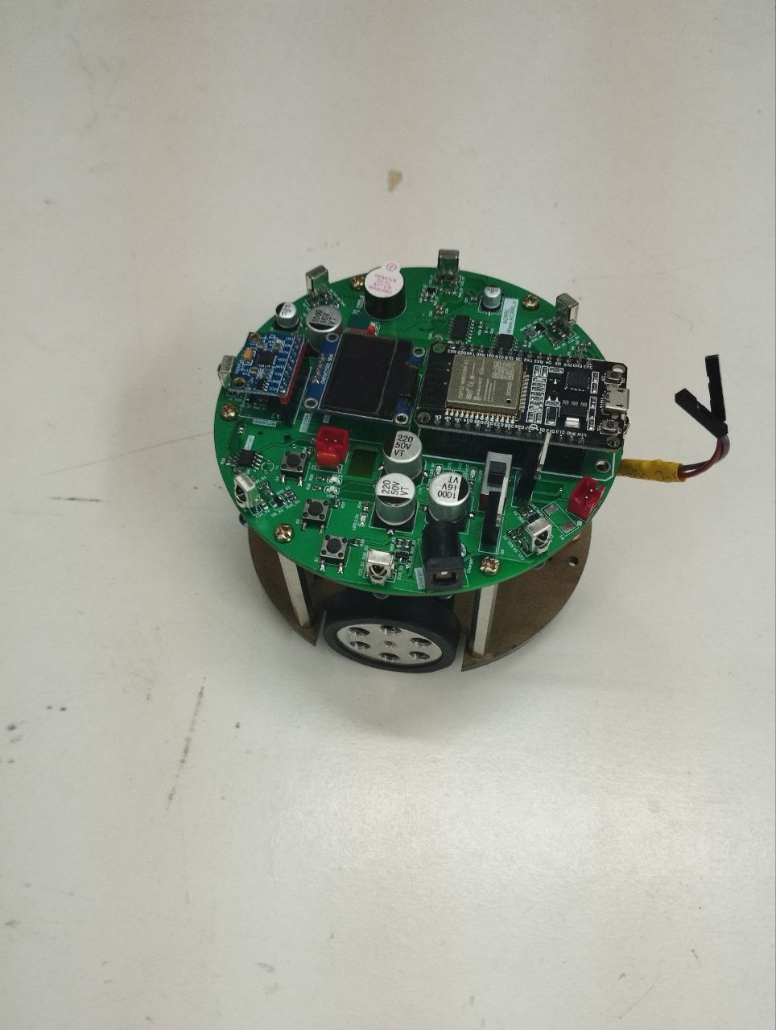
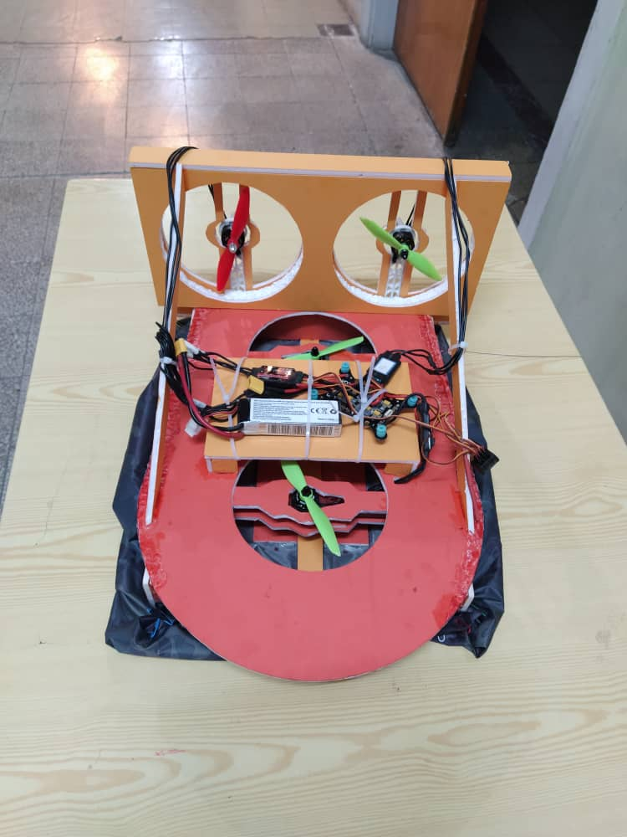
Research and operational experiences
1- Design and Implementation
Non-holonomic Mobile Robot.
2- Design and Implementation
Differential Mini-Mobile
robot for Swarm applications.
3- Patch planning and control the movement
of Hovercraft. (re modeling the dynamic and
kinematic with LPV method and design LPV
Controller by LMI techniques.
4- Design and Implementation controller algorithm
for 3 DOF special manipulator for robotic fountain.
Modeling and design motion controller board and algorithms
All Part : mechanical design, electronic design and implementation and programing
Completely done by myself
Completely done by myself

Slide 11
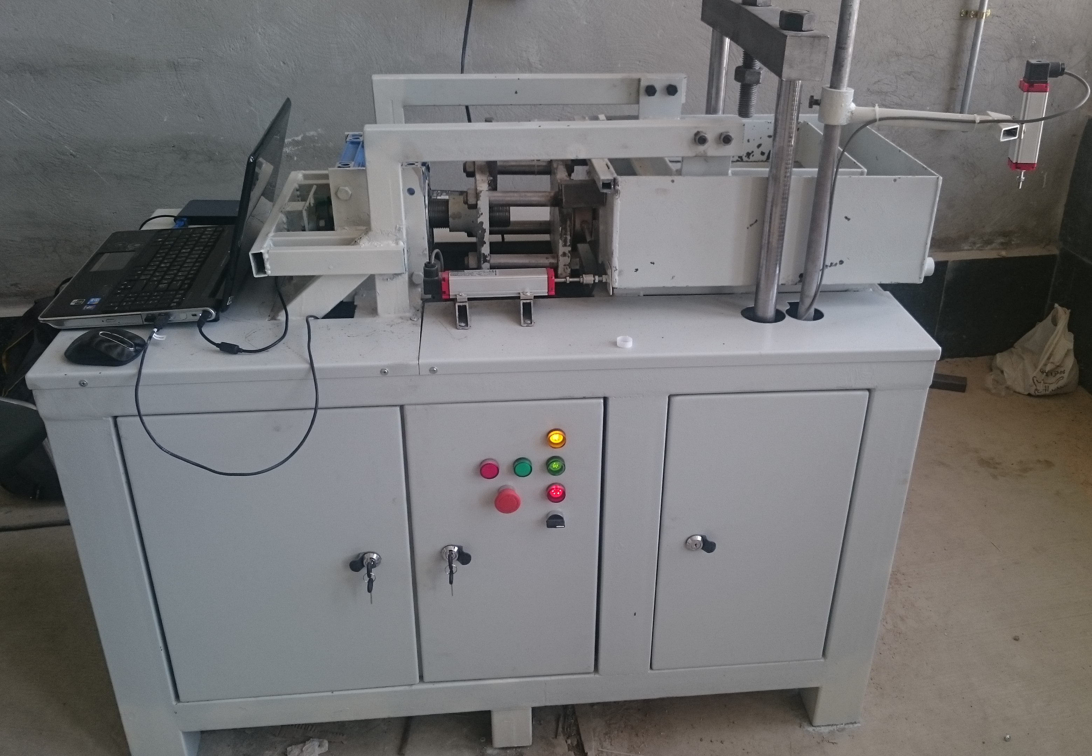
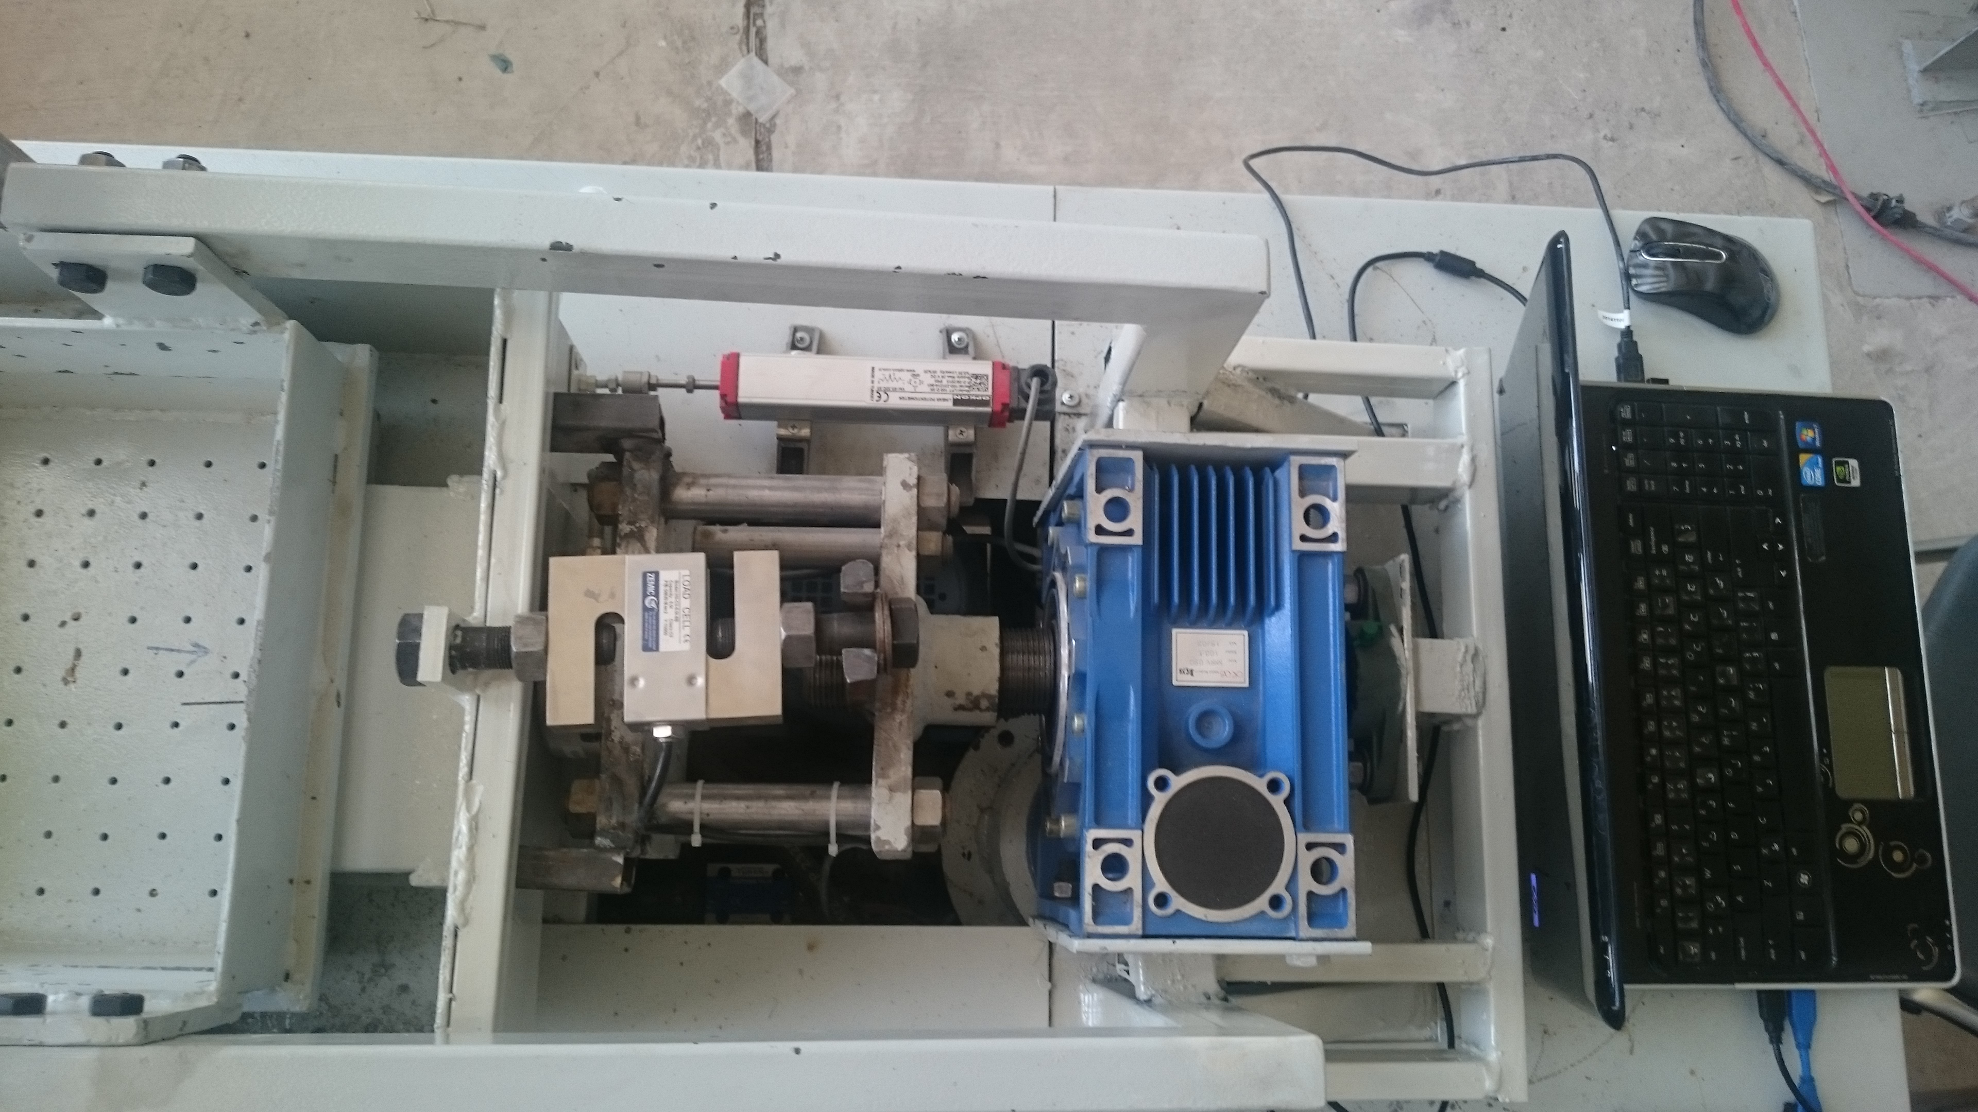
Research and operational experiences
1- Design and Implementation
Servo and stepper motor Driver.
2- Large Shear Apparatus
Design and programing
Mechanical Design, Programing, and implementation

Slide 12
Professional Experience
Work Experiences:
Internship in the GreenProject Company
Robotic Research at Minoosa company.
Research Assistant at Applied Control & Robotics Research Laboratory(ACRRL).
Research Assistant at Mechatronics Department at “Arioobarzan” company.
Designer engineer at “Kasbo Kar Jahan Jadid” company.
Teaching Experiences:
Teacher Assistant:
Computer Applications in Control (LabVIEW and Matlab), Shiraz University. (3 years)
Multi Input Multi Output Control, Shiraz University. (1 simester)
Modern Control, Shiraz University. (1 simister)

Slide 13
PROFESSIONAL SKILLS
• Programming Languages: C, C++, Python, PLC Programming.
• Technical Software: MATLAB, LabVIEW, Altium Designer, Proteus.
• Embedded Systems: ARM, AVR, PIC, Arduino, Raspberry Pi, NodeMCU.
• Robot Simulators: ROS, KUKA.Sim, CoppeliaSim.
• CAD Tools: SolidWorks, Core PTC, Siemens NX, Abaqus, 3D printing.
• Industrial Robot: KUKA, ABB.
• Libraries: OpenCV, TensorFlow, Keras.
• Operation Systems: Windows, Linux.
• Public Software: Microsoft Office, EdrawMax, Visio, Latex, Endnote, Mendeley.

Slide 14
Thank you for your consideration

Slide 15
AWARDS AND PRIZES
1st Place Gladiators Warrior Robot League, RoboSkill Competition under the Supervision of Kerman Technical and Vocational Training Organization, Aug. 2016.
Third place in 30 kg Warrior Robot League, RoboSkill Competition under the super vision of Kerman Technical and Vocational Training Organization, Aug. 2016.
Diploma of Honor In 15th National Skill Competitions in the field of robotics, Iran Technical and Vocational Training Organization, Karaj, Iran, Aug. 2014.
First place in National Skill Competitions, the provincial stage in the field of robotics, Iran Technical and Vocational Training Organization, Fars, Iran, Jun. 2014.
Second place in National Skill Competitions, the provincial stage in the field of robotics, Iran Technical and Vocational Training Organization, Fars, Iran, Jun. 2013.

Slide 16
EXTRA TRAINING
Altium Designer Software, Educational institution in Shiraz, Summer2019.
AVR microcontrollers, Educational institution in Shiraz, Summer2017.
Robotic teaching certificate,NURMS,Feb.2017.
Designer and analyst of AVR microcontrollers, Iran Technical and Vocational Training Organization, Jun.2017.
Entrepreneurship with the KAB method, Iran Technical and Vocational Training Organization, Jun.2017.
Installer of Intelligent Building Management System (BMS),Iran Technical and Vocational Training Organization,Nov.2016.
Assembly and installation of electrical panels, Iran Technical and VocationalTraining Organization,Sep.2016.
ICDL 2, Iran Technical and Vocational Training Organization,Sep.2016.
Industrial grade 2 electrical power, Iran Technical and Vocational TrainingOrganization,July2016.
Robotic Programming, Iran Technical and Vocational Training Organization,Oct.2014.
Basics of Robotic Concept, Iran Technical and Vocational Training Organization, Oct.2014.
Robotic Hardware, Iran Technical and Vocational Training Organization,Sep.2014.
MATLAB, South Industrial Management Institute(SIMI),Summer2013.

